Slide 1
Virtual Reality
Adapted from a lecture by
David Johnson

Slide 2
What is Virtual Reality?

Slide 3
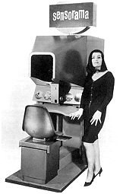
What is Virtual Reality?
Replace sensory input from real world with computer generated sensations
Sight
Hearing
Touch
Smell
Taste
Proprioceptic
Create a sense of immersion in that computer-generated world
presence
1956 – Heilig

Slide 4
VR as a Paradigm
VR is a paradigm for thinking about human-computer interfaces
What is the paradigm for a Windows PC?
What is the paradigm for an Xbox 360?
Others?
Augmented reality
Ubiquitous computing

Slide 5
VR as a Paradigm
VR is a paradigm for thinking about human-computer interfaces
What is the paradigm for a Windows PC?
What is the paradigm for an Xbox 360?
Others?
VR paradigm is
Immerse the user in data
Natural, emergent interface

Slide 6
VR History
70’s and 80’s – early work
Early 1990’s – immense enthusiasm
Virtuality arcade games
Late 90’s – immense disappointment
Researchers complain of the attention www is getting
Current – commodity elements available
Wii
Touch screens – iPhone, etc.
Personal video displays
Second Life, MMORPG
3D IMAX
G-speak

Slide 7
VR and Sensory Input
Much effort has been in developing technologies to immerse the user

Slide 8
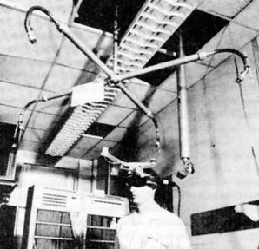
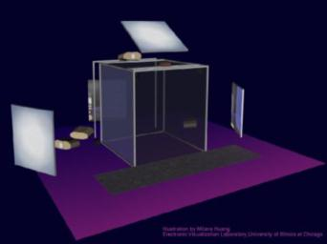
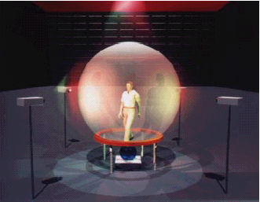
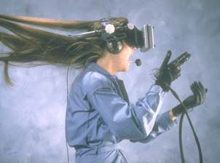
VR and Sight
Head-mounted display Powerwall CAVE
(HMD)
Ivan Sutherland developed the modern HMD at Utah (1969)

Slide 9
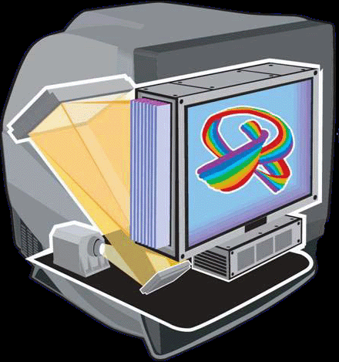
Current
Better HMDs
Sensics
Tiled OLED displays
4K x 2K resolution
Panoramic
Autostereoscopic displays
Higher-res CAVEs

Slide 10
VR and Touch
Two aspects
Know where the user’s body is
Tracking
Apply contact sensations to user
Haptics
Tactile interfaces

Slide 11
Position Tracking
Use sensors to track hand, head, body
Position
Orientation
Sensors are
Magnetic
Inertial
Ultrasound
Optical

Slide 12
Head Tracking
Very important for
HMD
CAVE
Fishtank VR
Can be done with a Wiimote
Johnny Lee
VR class project to use laptop camera
Sensitive to IR light

Slide 13
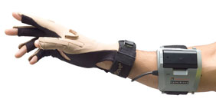
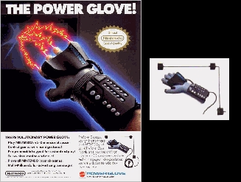
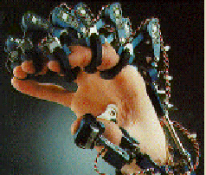
Hand Tracking
Allow natural interaction with virtual world
Grab
Gestures
Cyber glove

Slide 14
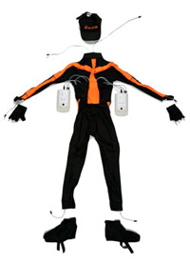
Body Tracking
More often used in motion capture systems
Film
TV
Games

Slide 15
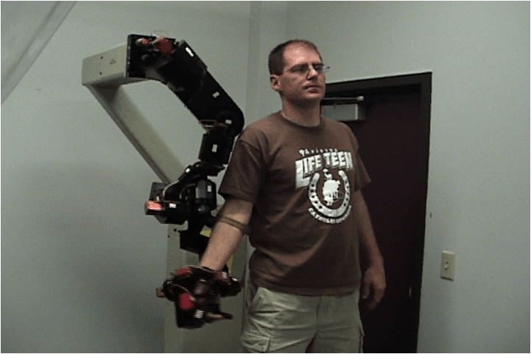
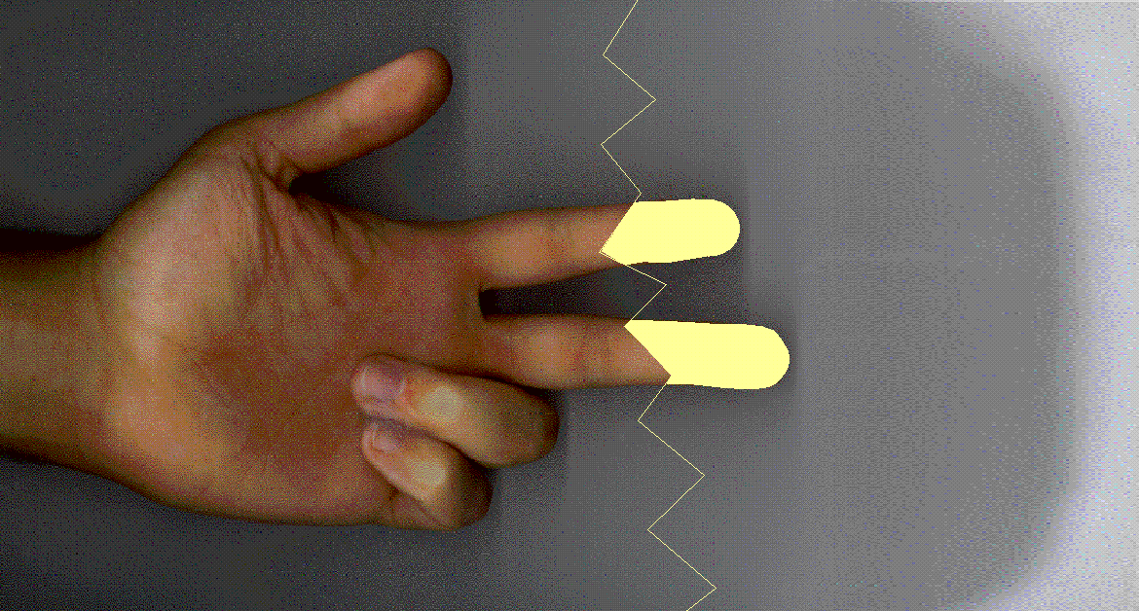
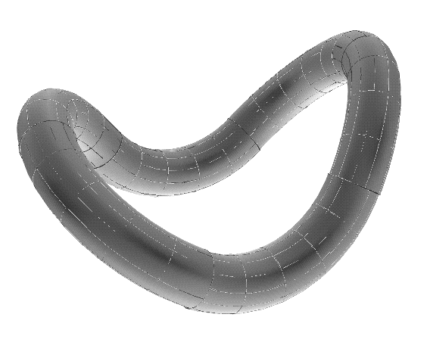
Haptics
Haptics = touch
Virtual objects apply real forces

Slide 16
Example

Slide 17
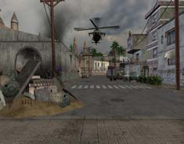
Sound in VR
Very important for immersion
Study of PTSD veterans using VR therapy found sound critical for creating sense of presence
Use headphones
Render sound
Example-fix

Slide 18
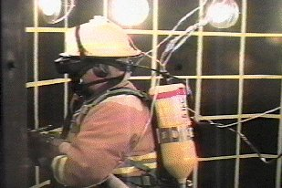
Olfactory Displays
DIVEpak
Computer controlled scratch and sniff
Smell-o-Vision (K Opticom)
6 gels, USB controlled
Fire Trainer
Odors range from burning wood, grease and rubber to sulfur, oil and diesel exhaust.

Slide 19
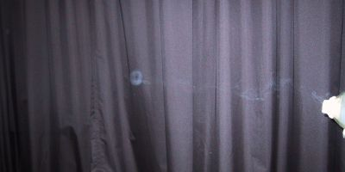
Smell Cannon
Track target with camera
Aim below eyes
Prerecorded smells

Slide 20
Gustatory Displays
Simulate the experience of eating
Iwata food simulator
Capture forces of eating
Playback
Combine flavors
five basic taste sensations: sweet, sour, bitter, salty and umami

Slide 21
VR Interfaces
How do we tell the computer to do things?
How do we select things?
How do we navigate around?

Slide 22
VR Interface Challenges
Intuitive
Make interaction work like the real world
Minimize cognitive overhead
Augmentation
Give users new capabilities

Slide 23
From the Beginning
Sutherland and Vickers
Sorcerer’s Apprentice (1972)
Track stylus
Selection of vertices
Intersection of cube at tip of stylus
Physical menu with see-through HMD!

Slide 24
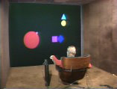
Pointing: Put That There
1979
Ray from tracked hand
Speech interface
movie

Slide 25
Pointing: JD-CAD (1993)
“Laser gun” from hand
Tracker noise
Harder to select far away
Spotlight
Add a cone to the ray
Select objects based on
Distance from cone axis
Distance from hand

Slide 26
Silk Cursor
Replace wireframe selection box with translucent box
Visual cues to containment

Slide 27
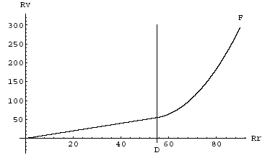
Hand: GoGo Interaction (1996)
Go-Go uses Non-Linear
mapping between
virtual and real hand
Control-display ratio
Stretch go-go variation
Pros:
Extended reach when needed
Direct manipulation
Cons:
Reach still limited by arm
length
Precision suffers when reach is
extended (low level of control)
Movie

Slide 28
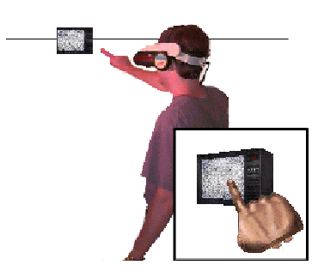
Image Plane Techniques
Point or gesture at an objects projection onto the viewing plane
“head-crusher”
Kids in the hall
“Sticky finger”
Similar to ray casting
Pros:
Very intuitive
Allows user to reach objects at an arbitrary distance
Cons:
Limited by the need for line of sight
Can be fatiguing
Virtual hand may obscure small objects

Slide 29
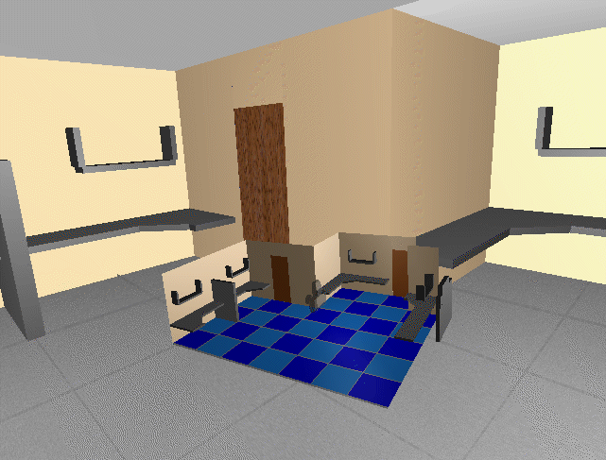
World in Miniature
User holds dynamic map in one hand
Objects can be moved in map

Slide 30
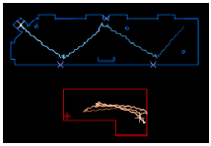
Exploring Large Virtual Spaces
Tracked spaces are expensive
Redirected walking
Movie
Treadmills
bicycles
Movie

Slide 31
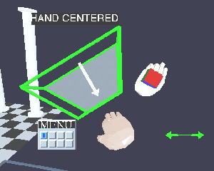
Menus in Virtual Space
Ring Menus
JDCAD 1993
Liang
ISAAC 1995
Mark Mine
Rotate hand to move selection point

Slide 32
Menus in Virtual Space
Lindeman 1999
Pen and Tablet
Track a tablet and pen
Put 2D menus on tablet

Slide 33
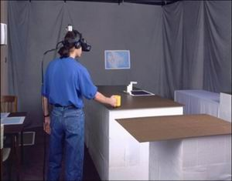
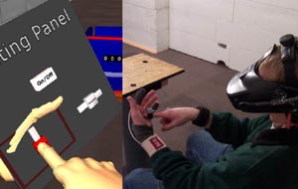
Physical Props
Tablet and pen
Passive haptics
Neurosurgical props
Haptic Hand

Slide 34
Menus in Virtual Space
Bowman
Pinch Gloves
Select with thumb to finger
High-level menu on ND hand
Secondary menu of D hand
First tries
Scrolling menu using pinches or
More items on pinkie

Slide 35
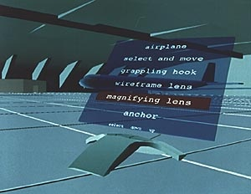
Menus in Virtual Spaces
‘Virtual tricorder’
Wloka 1995

Slide 36
Gestures
GIVEN (1992)
Neural net recognition
20 gestures
Fly, grab, etc.
Mine
“Physical mnemonics”
Pull-down menus from near head
Delete by throwing over shoulder

Slide 37
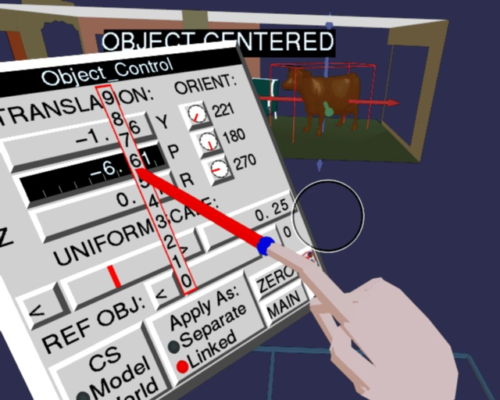
Numerical Input
No keyboards!
Mark Mine
A digit at a time
Sliders too imprecise

Slide 38
Who is using VR?
Military
Government
Big business
Common theme?

Slide 39
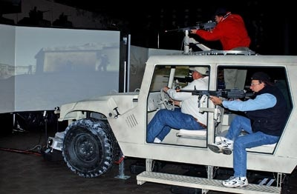
Military
Training
Telepresence

Slide 40
Scientific visualization
Virtual Wind Tunnel
NASA

Slide 41
Stress Therapy
VR therapy movie

Slide 42
Business infrastructure
telecollaboration

Slide 43
Medical
Medical training
Surgical playback
Medical planning and rehearsal
Surgical assistance
ultrasound
Biopsy

Slide 44
Medical
Surgical assistance
ultrasound
Biopsy
Robotic Surgery: daVinci
Brain Power: Reading Brain Waves
BrainGate: Invasive to Brain

Slide 45
Car companies
Evaluation
Style
Ergonomics
Manufacturability
Training

Slide 46
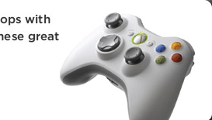
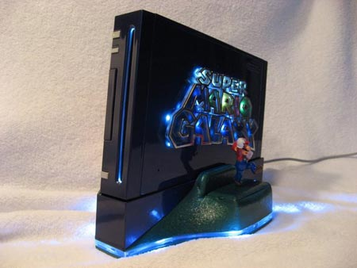
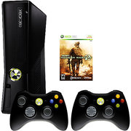
Video Games & Entertainment
Ubiquitous
Huge Industry
The 900 pound gorilla
Drives many aspects of the field

Slide 48
Conclusion
VR is like the space program
Lots of side benefits
Still little clear victory on the overall goal
Device technology is much improved
UI ideas are still primitive and inelegant

